Slide 1
Human trafficking: Modern-day slavery
Grades 9-12
Video (Show First One)

Slide 2
Did you know?
Each year, as many as 300,000 American children are at risk for sexual exploitation. The average age a child enters the commercial sex trade is 11-13 years old.

Slide 3
Human trafficking
Today we are going to talk about a dangerous problem-- human trafficking. Human trafficking happens everywhere; it can even happen right here in our own community. Human trafficking is when someone is recruited, hidden, or transported against their will for the purpose of forces labor, involuntary servitude, slavery, or for a commercial sex act. You can think of it as modern-day slavery.
We're going to talk about some of the tactics used by traffickers to find teens who are vulnerable, so they can exploit those teens for services and financial profit. It is important to know about this serious problem so that you can protect yourself and others from being victimized.
We know that sexual abuse is not your fault, and that you need to tell a trusted adult if you or someone you know is being abused. If you or someone you know is being victimized by a human trafficker, you must seek help."

Slide 4
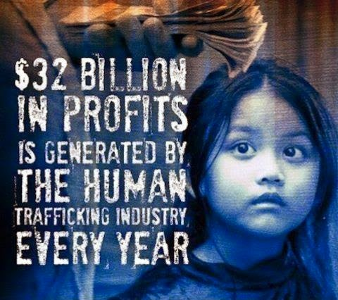
Human trafficking is a real problem!
We are going to watch a video about the problem of human trafficking. You will hear descriptions of what human trafficking is and how it can happen in our own community.
You will learn how human traffickers identify and target teens, and the risk factors that may make someone more vulnerable.
The video will also explore the techniques used by traffickers to take and maintain control of victims.
Finally, you will learn how to get help for yourself or a friend.

Slide 5
Video: Show Video 2 "Be the Change"
BE THE CHANGE

Slide 6
CLASS DISCUSSION
Distribute Human Trafficking Information Sheet
Discussion:
What is human trafficking?
Where does human trafficking occur?
Who is at risk of being a victim of human traffickers?
How is human trafficking modern-day slavery?
Human trafficking is not just a global problem, it can happen in our own community. In fact, Florida is third in the nation for reported human trafficking cases.

Slide 7
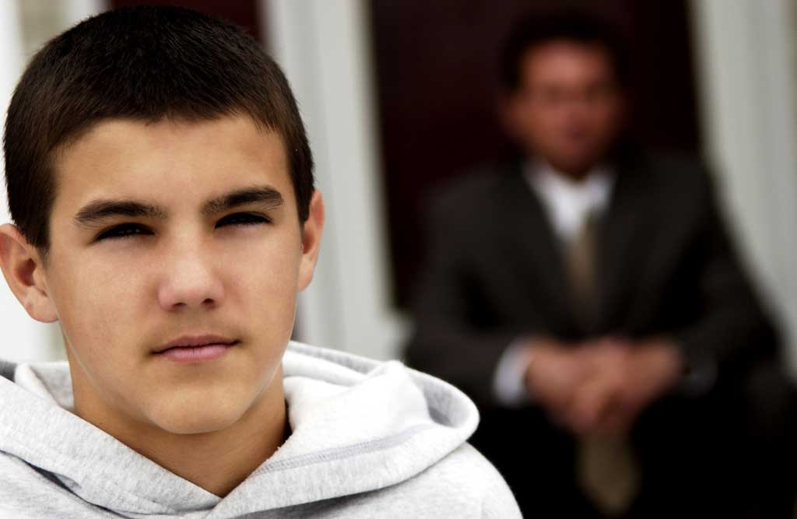
Spotlight – Human trafficking occurs when someone is recruited, hidden, or transported against their will for services and the financial gain of another person. This is sometimes referred to as "modern-day slavery." It is important to identify unsafe situations and unhealthy relationships that could put you at risk. Using your personal power to maintain the balance of power in relationships will help you stay safe.

